Slide 1

Detection and Prevention of Cyberbullying from Social Media by Exploring Machine Learning Algorithms
Group – A16
Supervisor:
Col Mohammad Shajahan Majib, psc
Senior Instructor
Department of Computer Science and Engineering
Military Institute of Science and Technology (MIST)
Mirpur Cantonment, Dhaka-1205
Co-supervisor:
Nafiz Imtiaz Khan
Lecturer
Department of Computer Science and Engineering
Military Institute of Science and Technology (MIST)
Mirpur Cantonment, Dhaka-1205
Group Members:
Tasfia Tasnim 201814029
Shutonu Mitra 201814033
Md Arr Rafi Islam 201814050
Detection and Prevention of Cyberbullying
IC4ME2 Detection and Prevention of Cyberbullying

Slide 2
Introduction
Literature Review
Objective
Methodology
OUTLINE
Conceptual Framework
Obtained Results
Limitations
Future Work
01
A16 Detection and Prevention of Cyberbullying

Slide 3
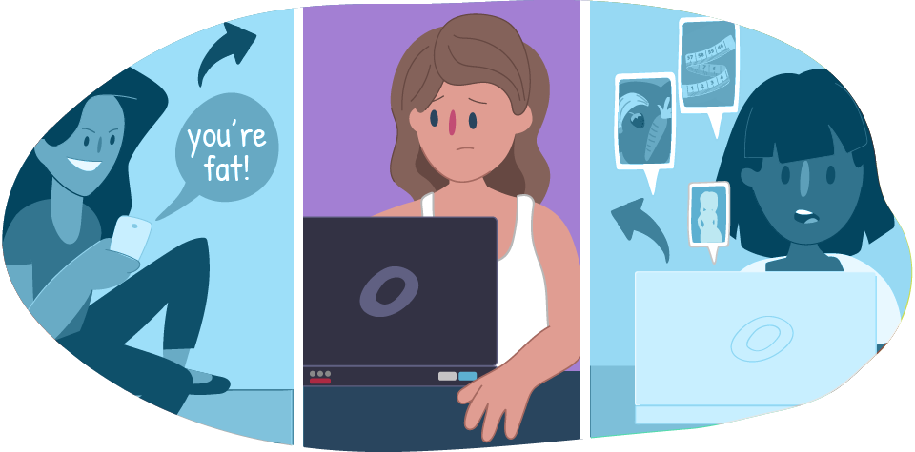
Introduction
02
IC4ME2 Detection and Prevention of Cyberbullying
A16 Detection and Prevention of Cyberbullying

Slide 4
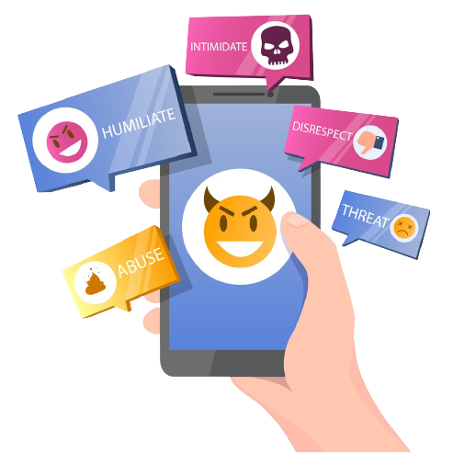
Introduction
Social media is the main platform of communication to express opinions
People share quality contents in social media that might go viral in negative ways
03
A16 Detection and Prevention of Cyberbullying
IC4ME2 Detection and Prevention of Cyberbullying

Slide 5
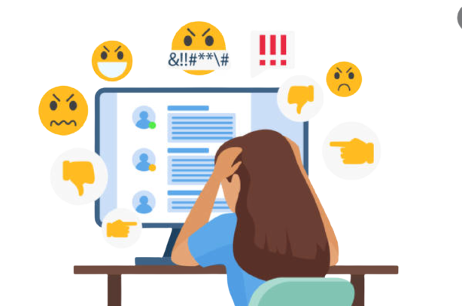
Introduction
Cyberbullying is a sub-form of bullying with electronic devices
Victims of Cyberbully have depression, anxiety, suicidal tendencies
Personal appearance is the most common reason of cyberbullying followed by racism, religion and sexual discrimination
04
A16 Detection and Prevention of Cyberbullying
IC4ME2 Detection and Prevention of Cyberbullying

Slide 6
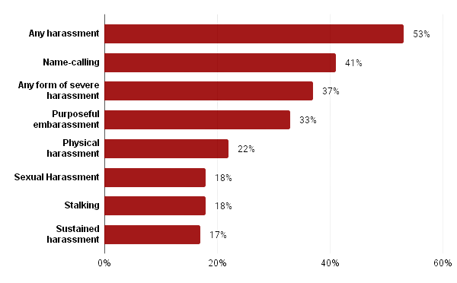
Introduction
(Statistics)
05
A16 Detection and Prevention of Cyberbullying

Slide 7


Introduction
37% experienced negativity online and 54% reported being worried about online bullying.
Social media is only concerned about accessibility, not the consequences of cyberbullying.
06
A16 Detection and Prevention of Cyberbullying
IC4ME2 Detection and Prevention of Cyberbullying

Slide 8
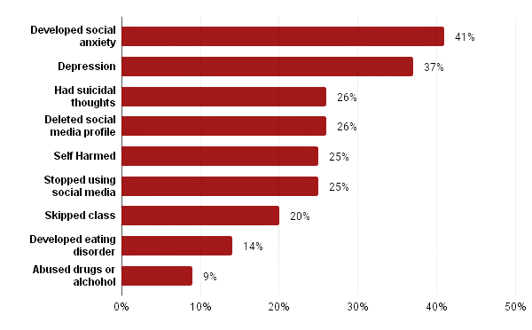
Introduction
(Statistics)
07
A16 Detection and Prevention of Cyberbullying
IC4ME2 Detection and Prevention of Cyberbullying

Slide 9
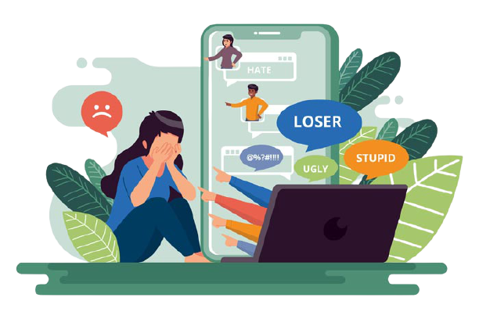
What is Cyberbully???
08
A16 Detection and Prevention of Cyberbullying
IC4ME2 Detection and Prevention of Cyberbullying

Slide 10
Literature Review
Scope | Ref | Summary
Detecting and classifying cyberbullying | [1] | Early detection of cyberbullying using linear kernel support vector machine
 | [2] | Capturing troll behavior and identifying troll accounts using Inverse Reinforcement Learning
 | [3] | Detecting cyberbullying rumors using Naïve Bayes and the Random Forest algorithms
 | [4] | Distinguishing trolls and non-trolls by training an L2-regularized Logistic Regression with LIBLINEAR
 | [5] | Detecting trolls by a three layer neural network architecture
 | [6] | Proposing a novel cyberbullying detection framework in multi-modal contexts
09
A16 Detection and Prevention of Cyberbullying
IC4ME2 Detection and Prevention of Cyberbullying

Slide 11
Literature Review
Scope | Ref | Summary
Prevention or elimination of cyberbullying | [7] | Proposing a framework to monitor and control the flow of messages in social media
 | [8] | Detecting trolls and a response grading system which takes action on basis of severity of bully
 | [9] | Detecting and preventing of cyberbully using text mining and machine learning techniques
 | [10] | Proposing a novel approach that satisfies key properties(accuracy, repetitiveness, timeliness and efficiency) for cyberbully detection
10
A16 Detection and Prevention of Cyberbullying
IC4ME2 Detection and Prevention of Cyberbullying

Slide 12
Summary
Different algorithms are used for detection
Various accuracy for using different word embedding techniques for feature extraction
Mainly focused on detecting cyberbully or trolls

Slide 13
Objectives
To explore how ML algorithms are applied to any text to detect and categorize bully content
To measure the sentiment of any speech or text by using NLP techniques
To compare the performance of existing ML algorithms applied on SM for the detection of cyberbullying.
To propose a framework for the prevention of bullies using a model built on the best performing ML algorithm on the collected dataset
11
A16 Detection and Prevention of Cyberbullying
IC4ME2 Detection and Prevention of Cyberbullying

Slide 14
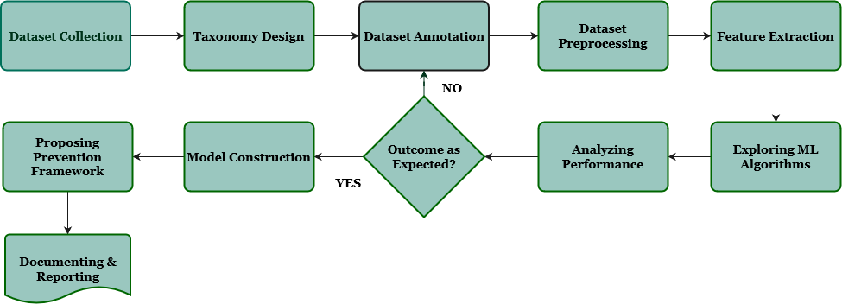
Methodology
12
A16 Detection and Prevention of Cyberbullying
IC4ME2 Detection and Prevention of Cyberbullying
IC4ME2 Detection and Prevention of Cyberbullying

Slide 15
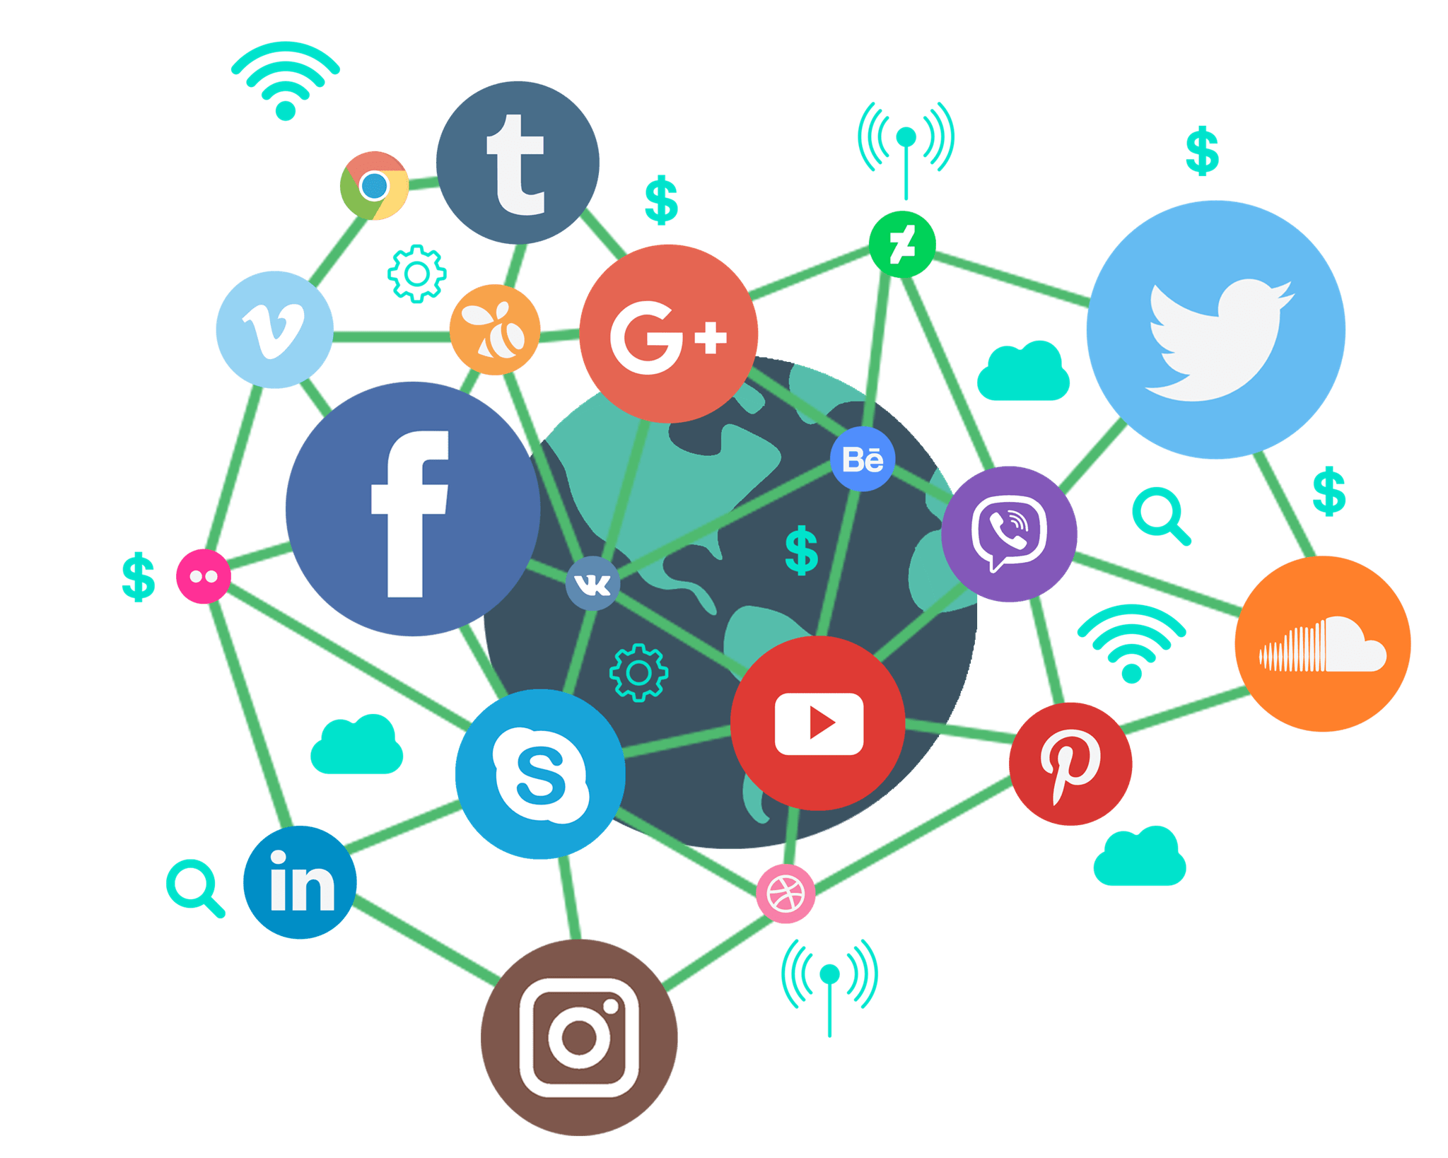
Methodology
Dataset Collection & Annotation:
The public tweets are collected using Python’s Twitter API.
Some keywords used are the recent trending topics.
The bully identification model is able to classify tweets in two classes:
Positive Sentiment
Negative Sentiment
For identification model the dataset is annotated using VADER (Valence Aware Dictionary for Sentiment Reasoning) sentiment analyzer.
13
A16 Detection and Prevention of Cyberbullying
IC4ME2 Detection and Prevention of Cyberbullying

Slide 16

Methodology
The bully classification model shall be able to classify tweets into six classes:
Racism
Offensive
Misogyny
Attacking
Positive
Neutral
For classification model the dataset is annotated manually and the Cohen’s kappa score for three annotators annotation is 0.83.
IC4ME2 Detection and Prevention of Cyberbullying
14
A16 Detection and Prevention of Cyberbullying
IC4ME2 Detection and Prevention of Cyberbullying

Slide 17
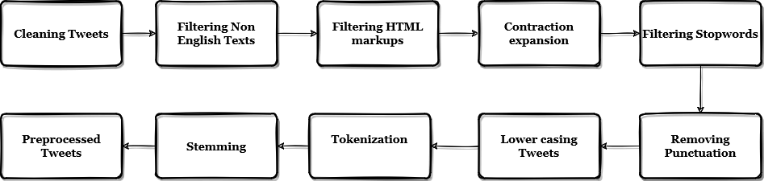
Methodology
Data Preprocessing:
15
A16 Detection and Prevention of Cyberbullying
IC4ME2 Detection and Prevention of Cyberbullying

Slide 18
Methodology
Building ML Models:
Techniques used for feature extraction:
Bag of Words ( BoW)
Term Frequency Inverse Document Frequency (TFIDF)
GloVe word embedding
Machine Learning algorithms considered in this study are :
Liblinear based logistic regression
Multinomial Naive Bayes
Random Forest
Linear SVM
Bidirectional LSTM Network
16
A16 Detection and Prevention of Cyberbullying
IC4ME2 Detection and Prevention of Cyberbullying

Slide 19

Methodology
Analyzing Performance:
In both cases, a random train test split of 70-30 was done, where 70% data was considered as the training dataset, while 30% data was considered as the test dataset.
The metrics used for performance analysis are:
Precision, Recall and F1 score.
Confusion Matrix.
ROC curve.
17
A16 Detection and Prevention of Cyberbullying
IC4ME2 Detection and Prevention of Cyberbullying

Slide 20
Methodology
Performance of Bully Identification Model
Models |  | Train Set |  |  | Test Set
Embedding | Algorithm | Precision | Recall | F1 | Precision | Recall | F1
BOW | Log regression | 0.832 | 0.830 | 0.830 | 0.782 | 0.779 | 0.778
 | Naive Bayes | 0.765 | 0.765 | 0.765 | 0.723 | 0.723 | 0.723
 | SVM | 0.837 | 0.834 | 0.834 | 0.774 | 0.769 | 0.768
 | RF | 0.893 | 0.883 | 0.882 | 0.750 | 0.747 | 0.746
TFIDF | Log regression | 0.892 | 0.892 | 0.892 | 0.794 | 0.794 | 0.794
 | Naive Bayes | 0.873 | 0.873 | 0.873 | 0.742 | 0.742 | 0.742
 | SVM | 0.910 | 0.909 | 0.909 | 0.781 | 0.781 | 0.781
 | RF | 0.943 | 0.937 | 0.937 | 0.813 | 0.809 | 0.808
18
A16 Detection and Prevention of Cyberbullying
IC4ME2 Detection and Prevention of Cyberbullying

Slide 21
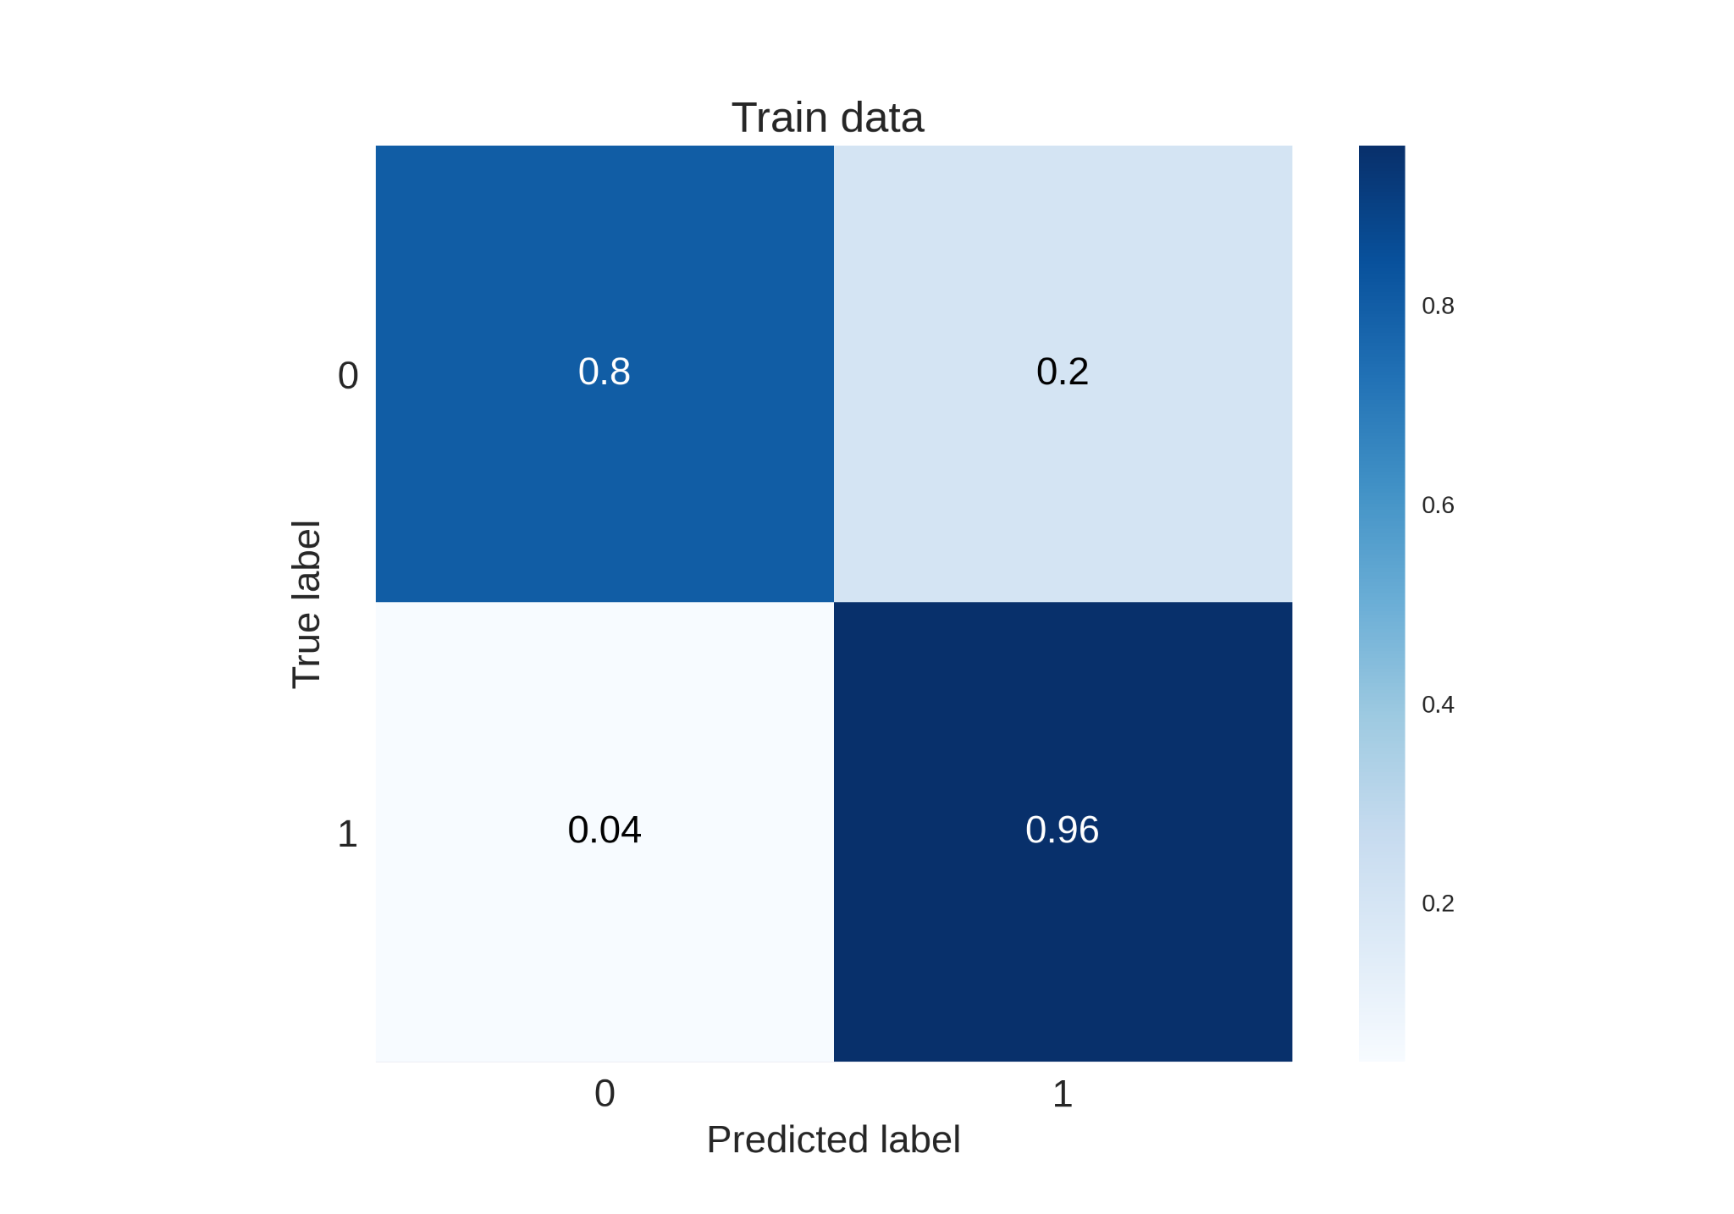
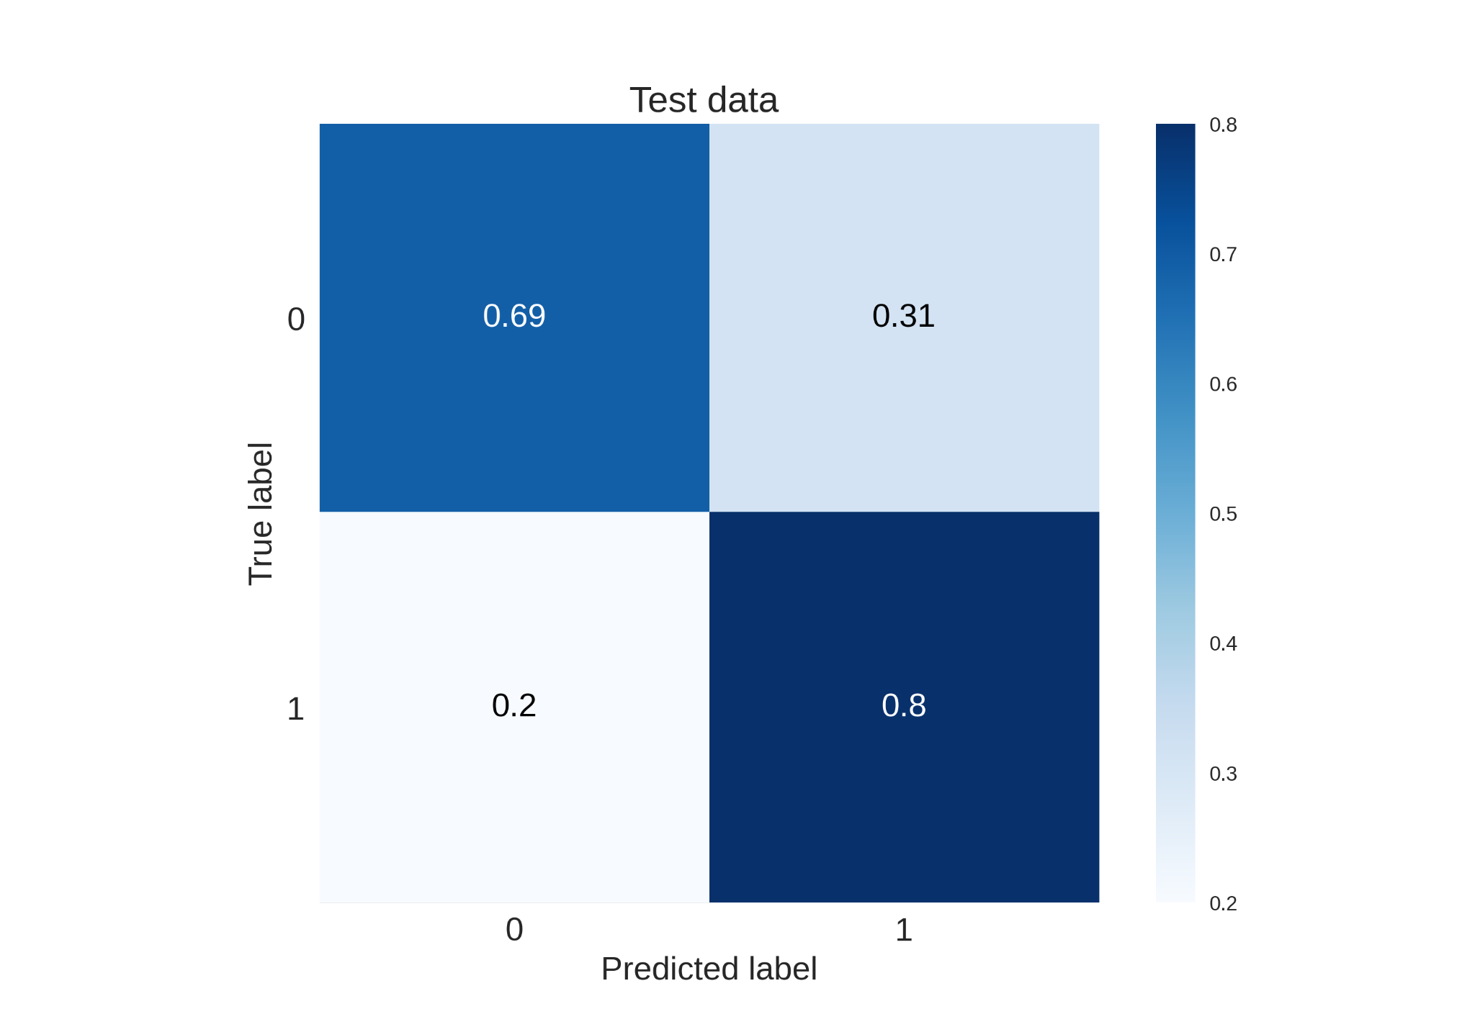
Methodology
Confusion Matrices for Log Regression with BoW
19
A16 Detection and Prevention of Cyberbullying
IC4ME2 Detection and Prevention of Cyberbullying

Slide 22
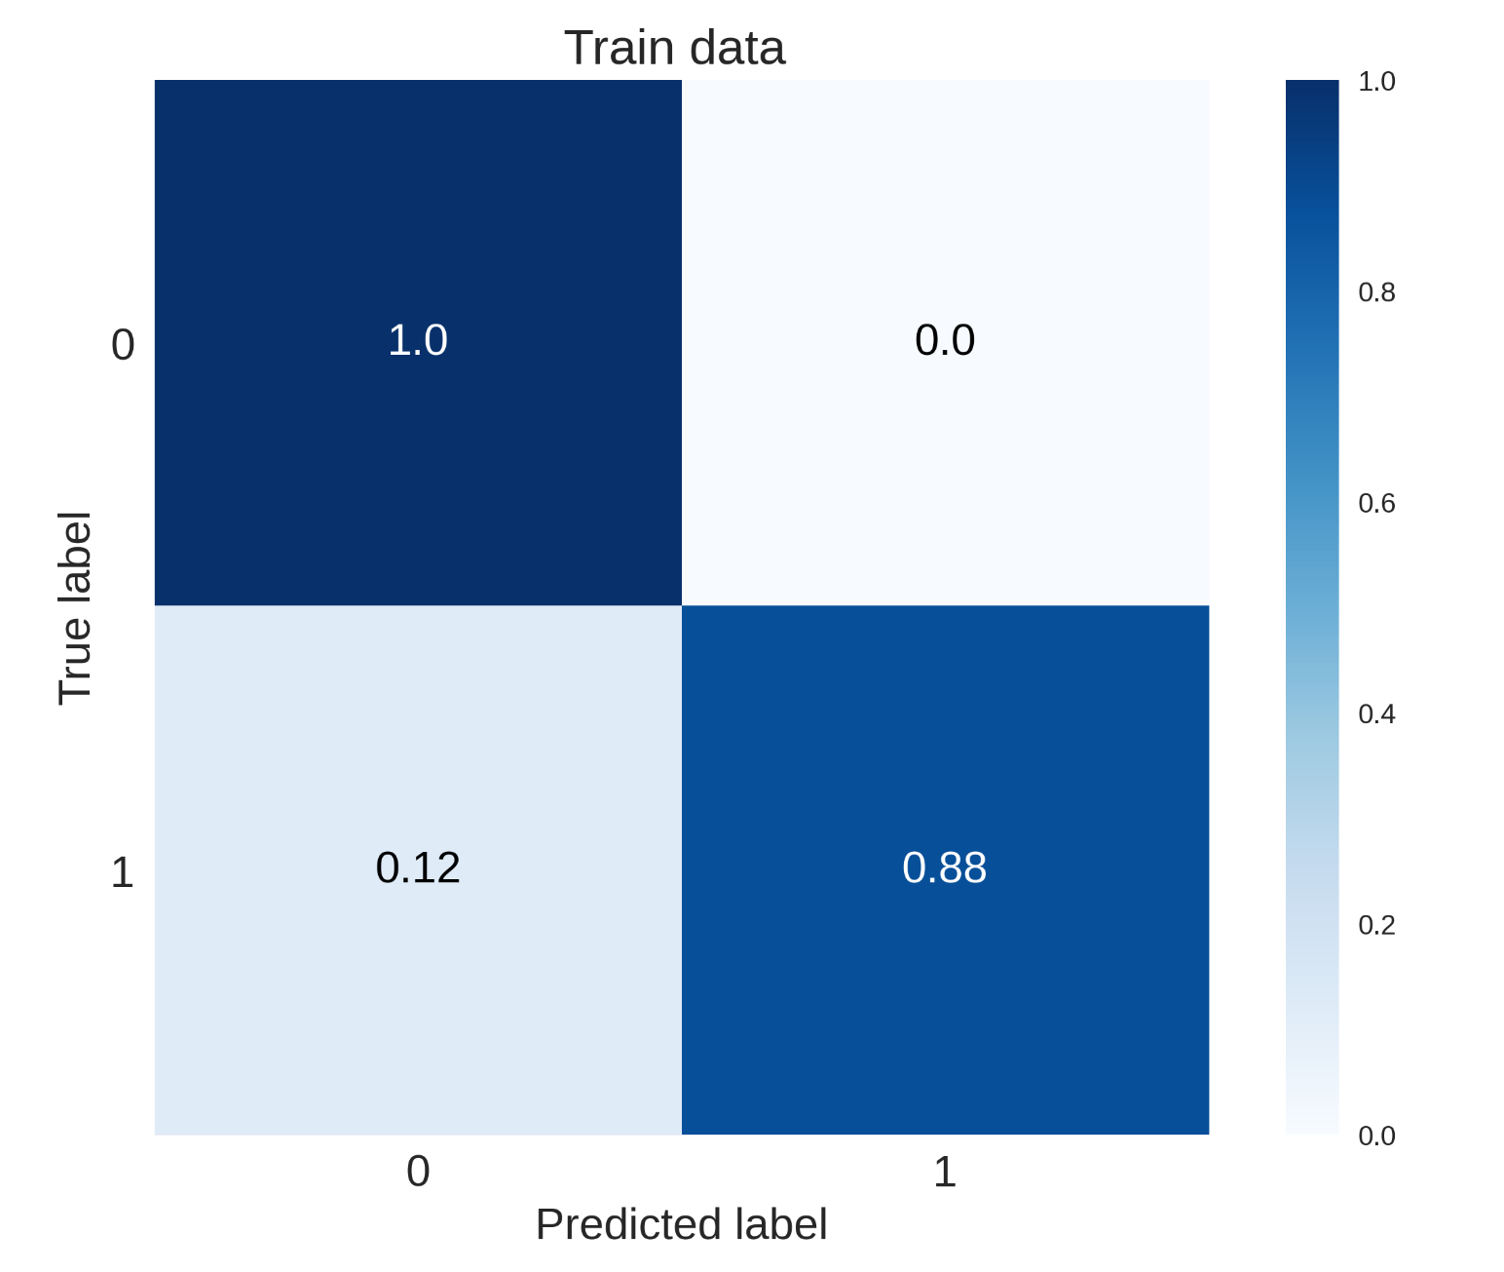
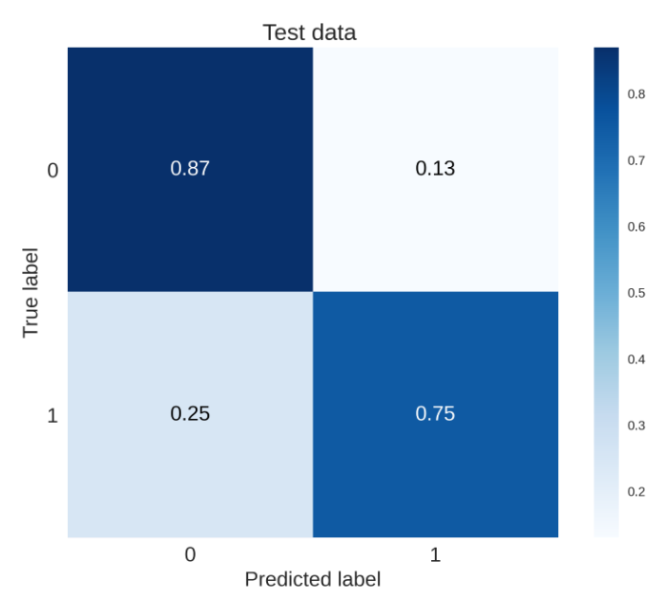
Methodology
Confusion Matrices RF with TFIDF
20
A16 Detection and Prevention of Cyberbullying
IC4ME2 Detection and Prevention of Cyberbullying

Slide 23
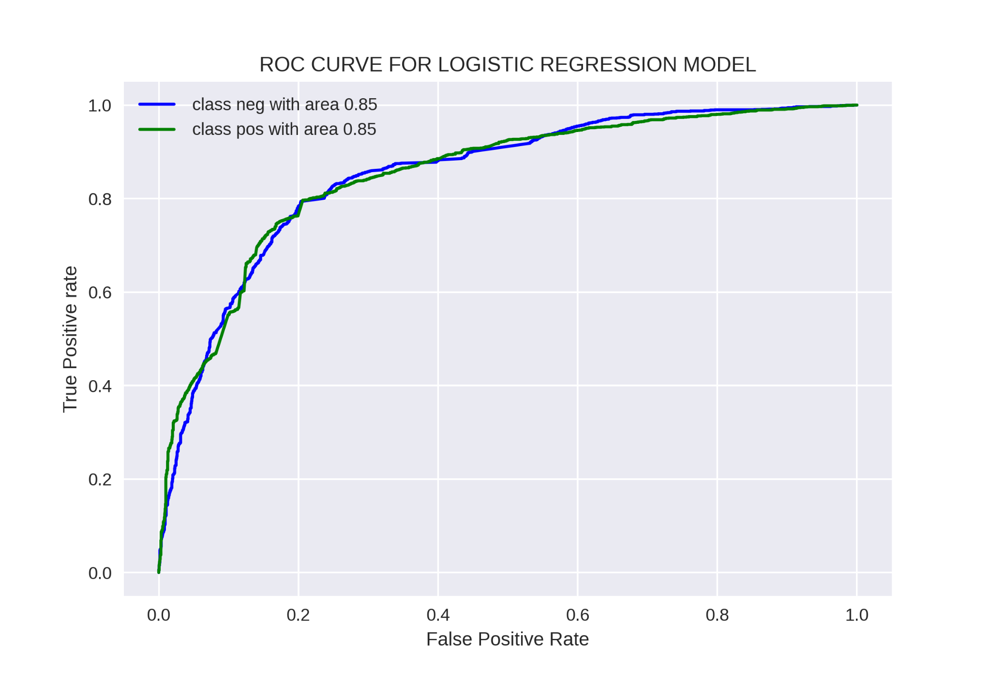
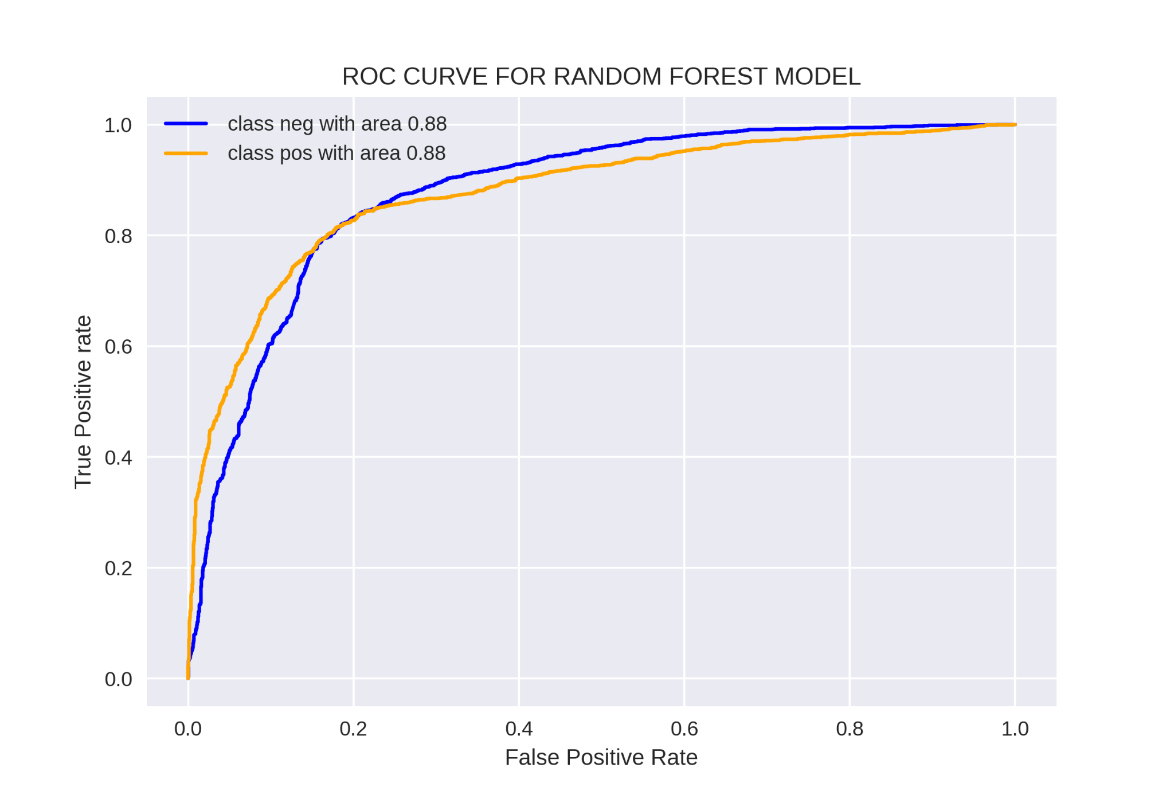
Methodology
ROC curves for models: Log Regression with BOW
ROC curves for models: RF with TFIDF
21
A16 Detection and Prevention of Cyberbullying
IC4ME2 Detection and Prevention of Cyberbullying

Slide 24
Methodology
Performance of Bully Classification Model
Models |  | Train Set |  |  | Test Set
Embedding | Algorithm | Precision | Recall | F1 | Precision | Recall | F1
BOW | Log regression | 0.823 | 0.759 | 0.771 | 0.617 | 0.515 | 0.515
 | Naive Bayes | 0.766 | 0.705 | 0.714 | 0.571 | 0.491 | 0.490
 | SVM | 0.860 | 0.792 | 0.805 | 0.648 | 0.506 | 0.511
 | RF | 0.872 | 0.806 | 0.818 | 0.637 | 0.527 | 0.524
TFIDF | Log regression | 0.834 | 0.838 | 0.835 | 0.626 | 0.559 | 0.576
 | Naive Bayes | 0.835 | 0.827 | 0.815 | 0.553 | 0.543 | 0.544
 | SVM | 0.888 | 0.885 | 0.886 | 0.596 | 0.489 | 0.505
 | RF | 0.980 | 0.979 | 0.979 | 0.637 | 0.617 | 0.622
GloVe | BiLSTM | 0.927 | 0.879 | 0.901 | 0.908 | 0.852 | 0.877
22
A16 Detection and Prevention of Cyberbullying
IC4ME2 Detection and Prevention of Cyberbullying

Slide 25
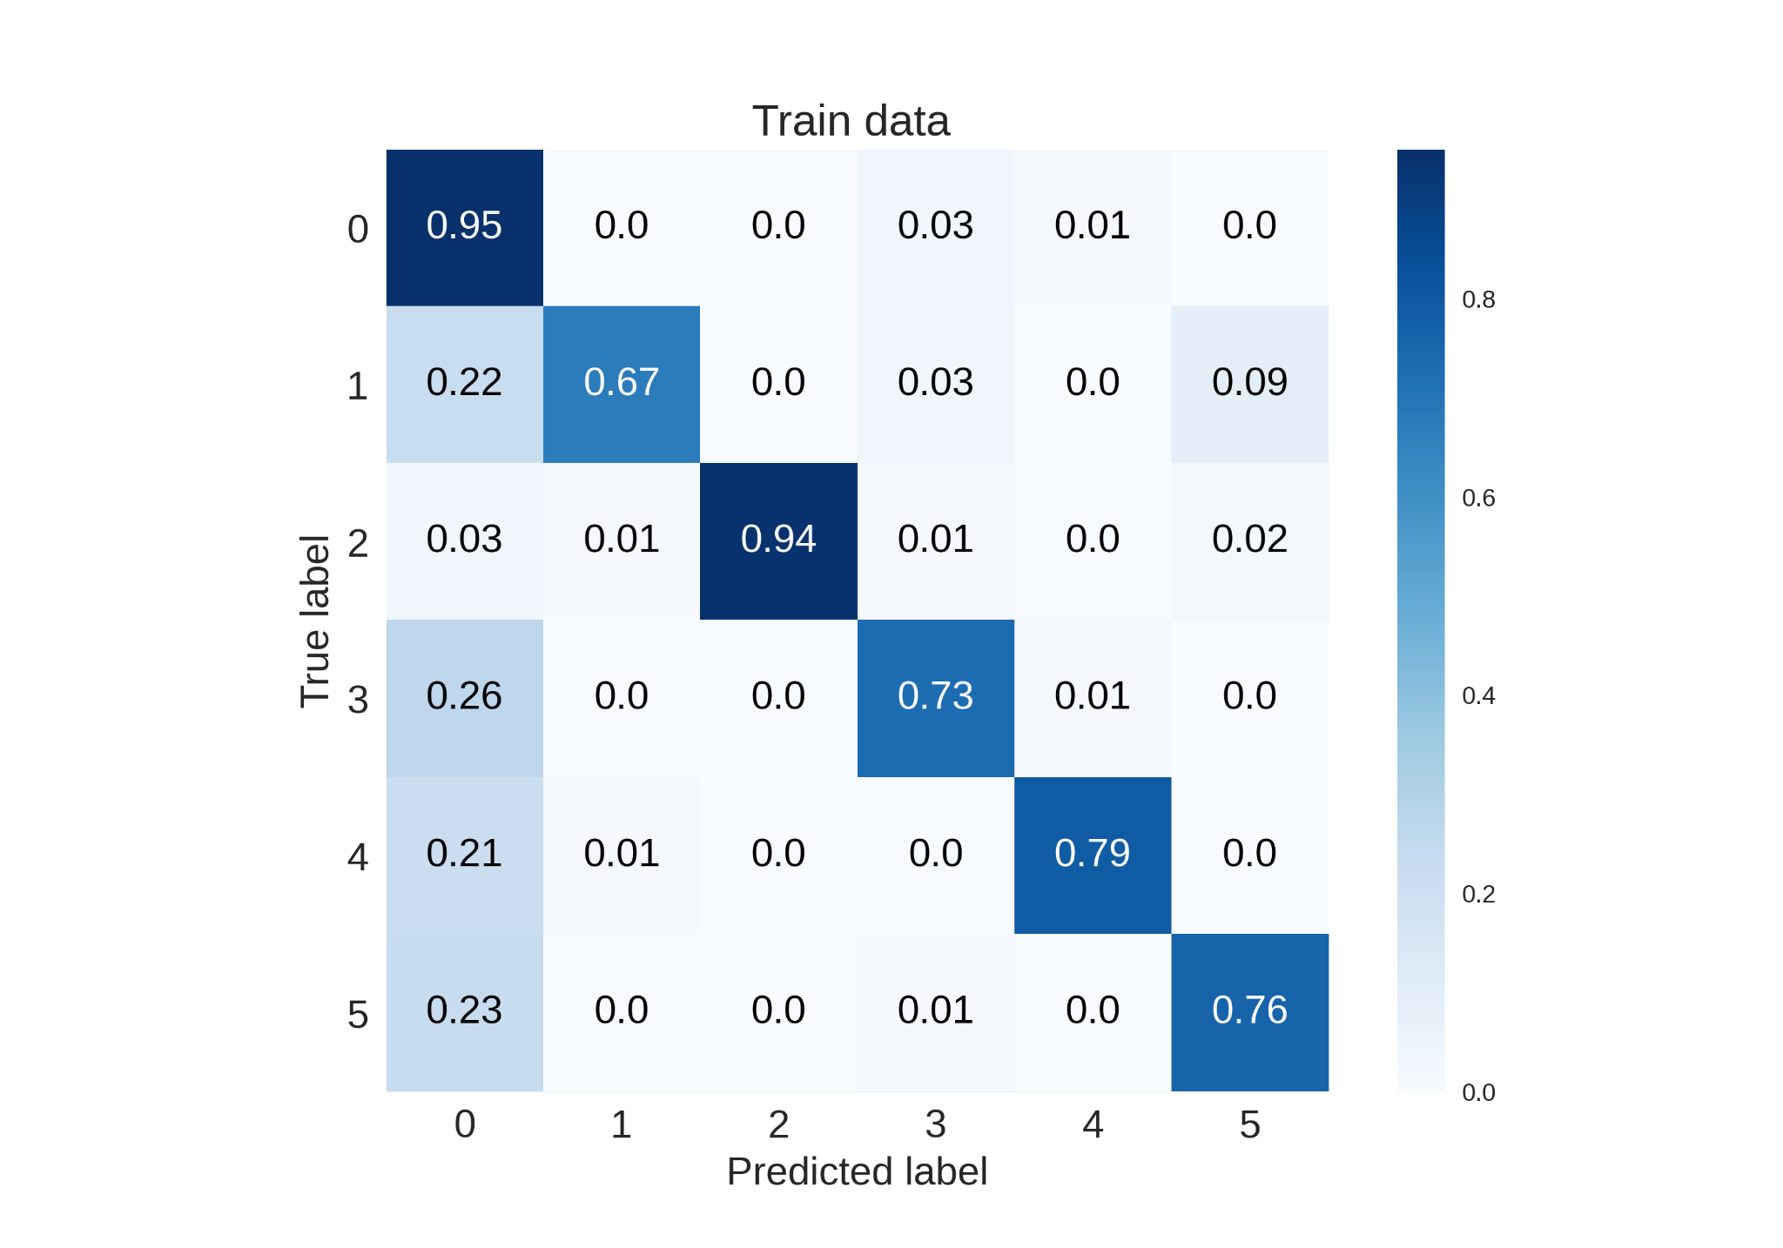
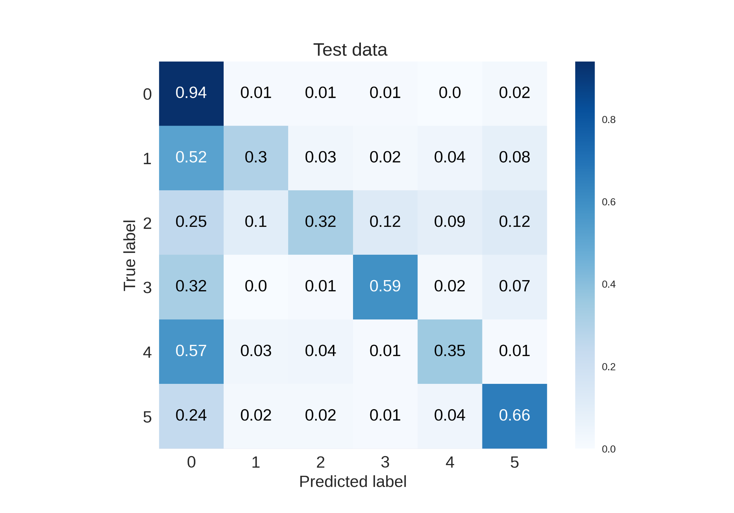
Methodology
Confusion Matrices for RF with BoW
23
A16 Detection and Prevention of Cyberbullying
IC4ME2 Detection and Prevention of Cyberbullying

Slide 26
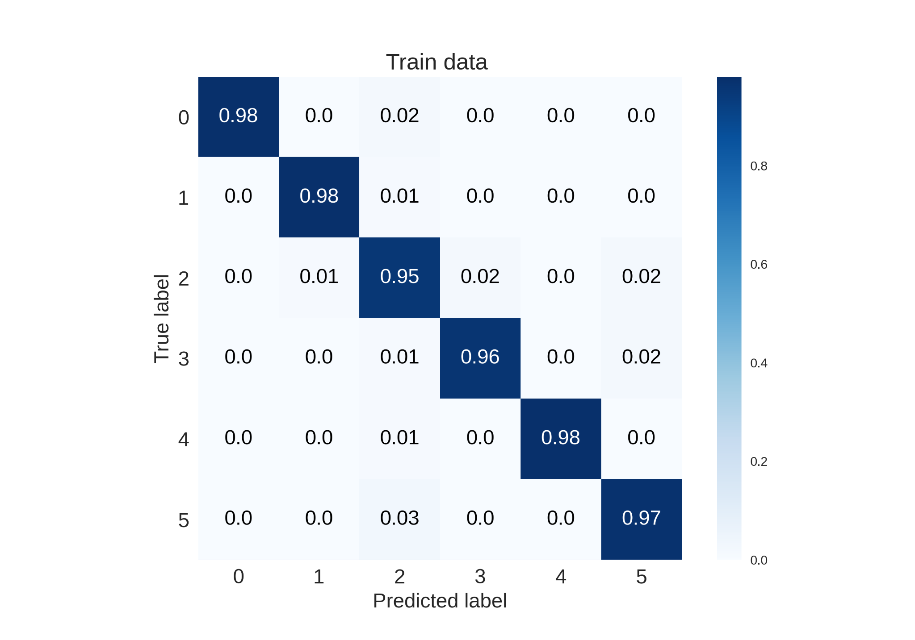
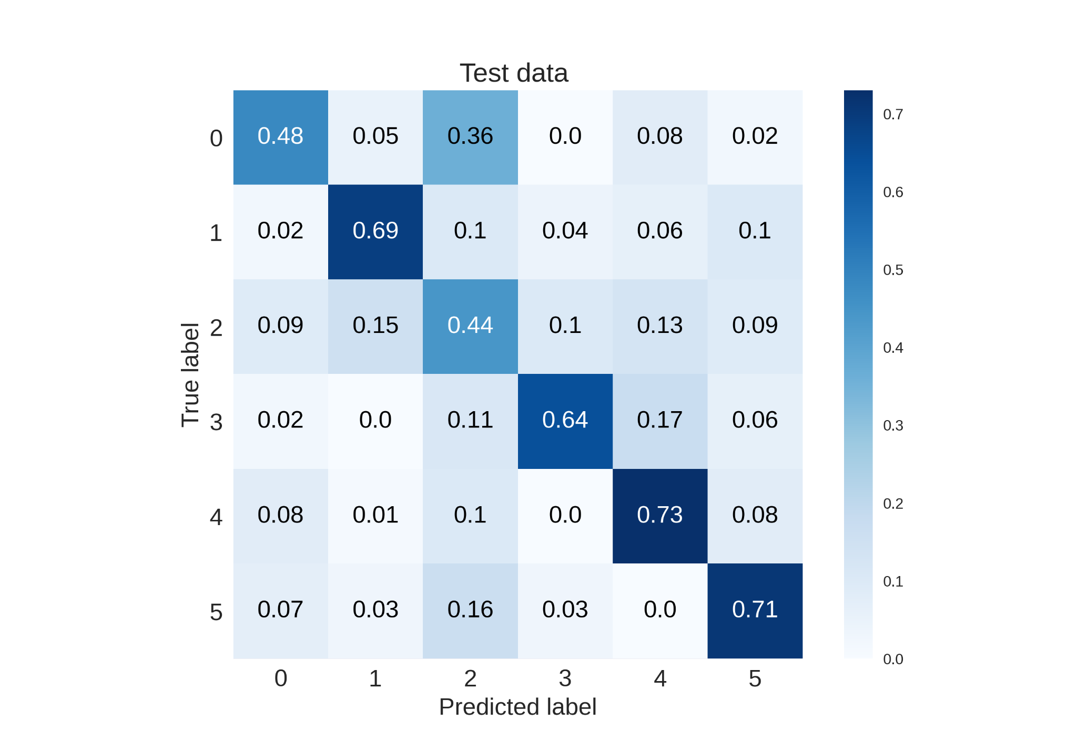
Methodology
Confusion Matrices for RF with TFIDF
24
A16 Detection and Prevention of Cyberbullying
IC4ME2 Detection and Prevention of Cyberbullying

Slide 27
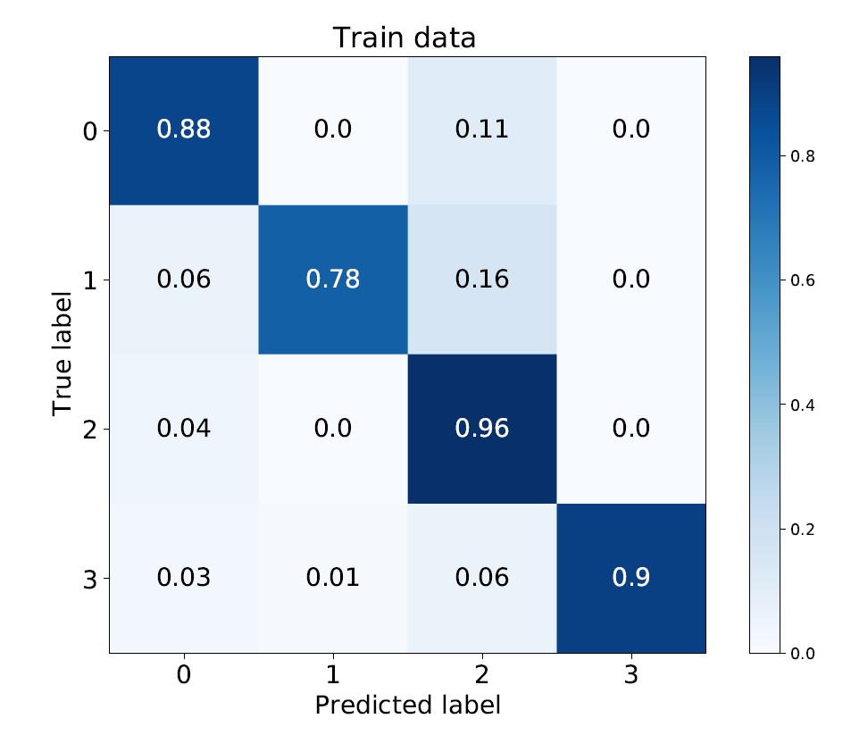
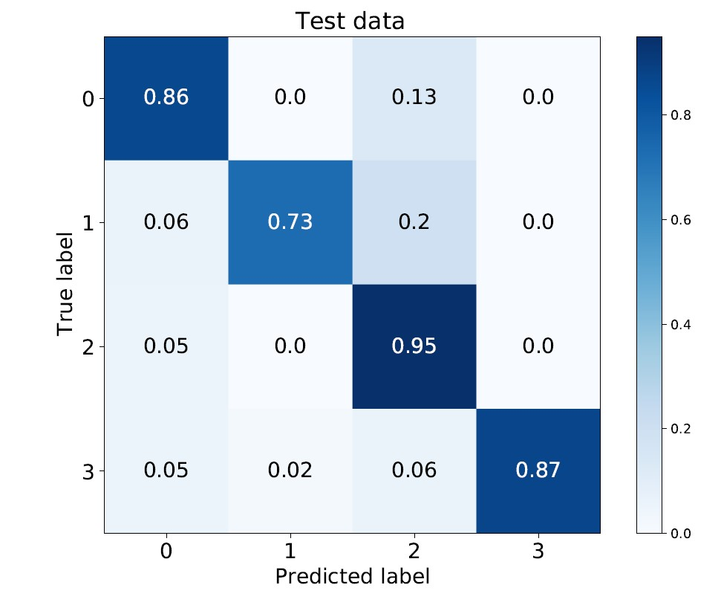
Methodology
Confusion Matrices for BiLSTM with GloVe
25
A16 Detection and Prevention of Cyberbullying
IC4ME2 Detection and Prevention of Cyberbullying

Slide 28
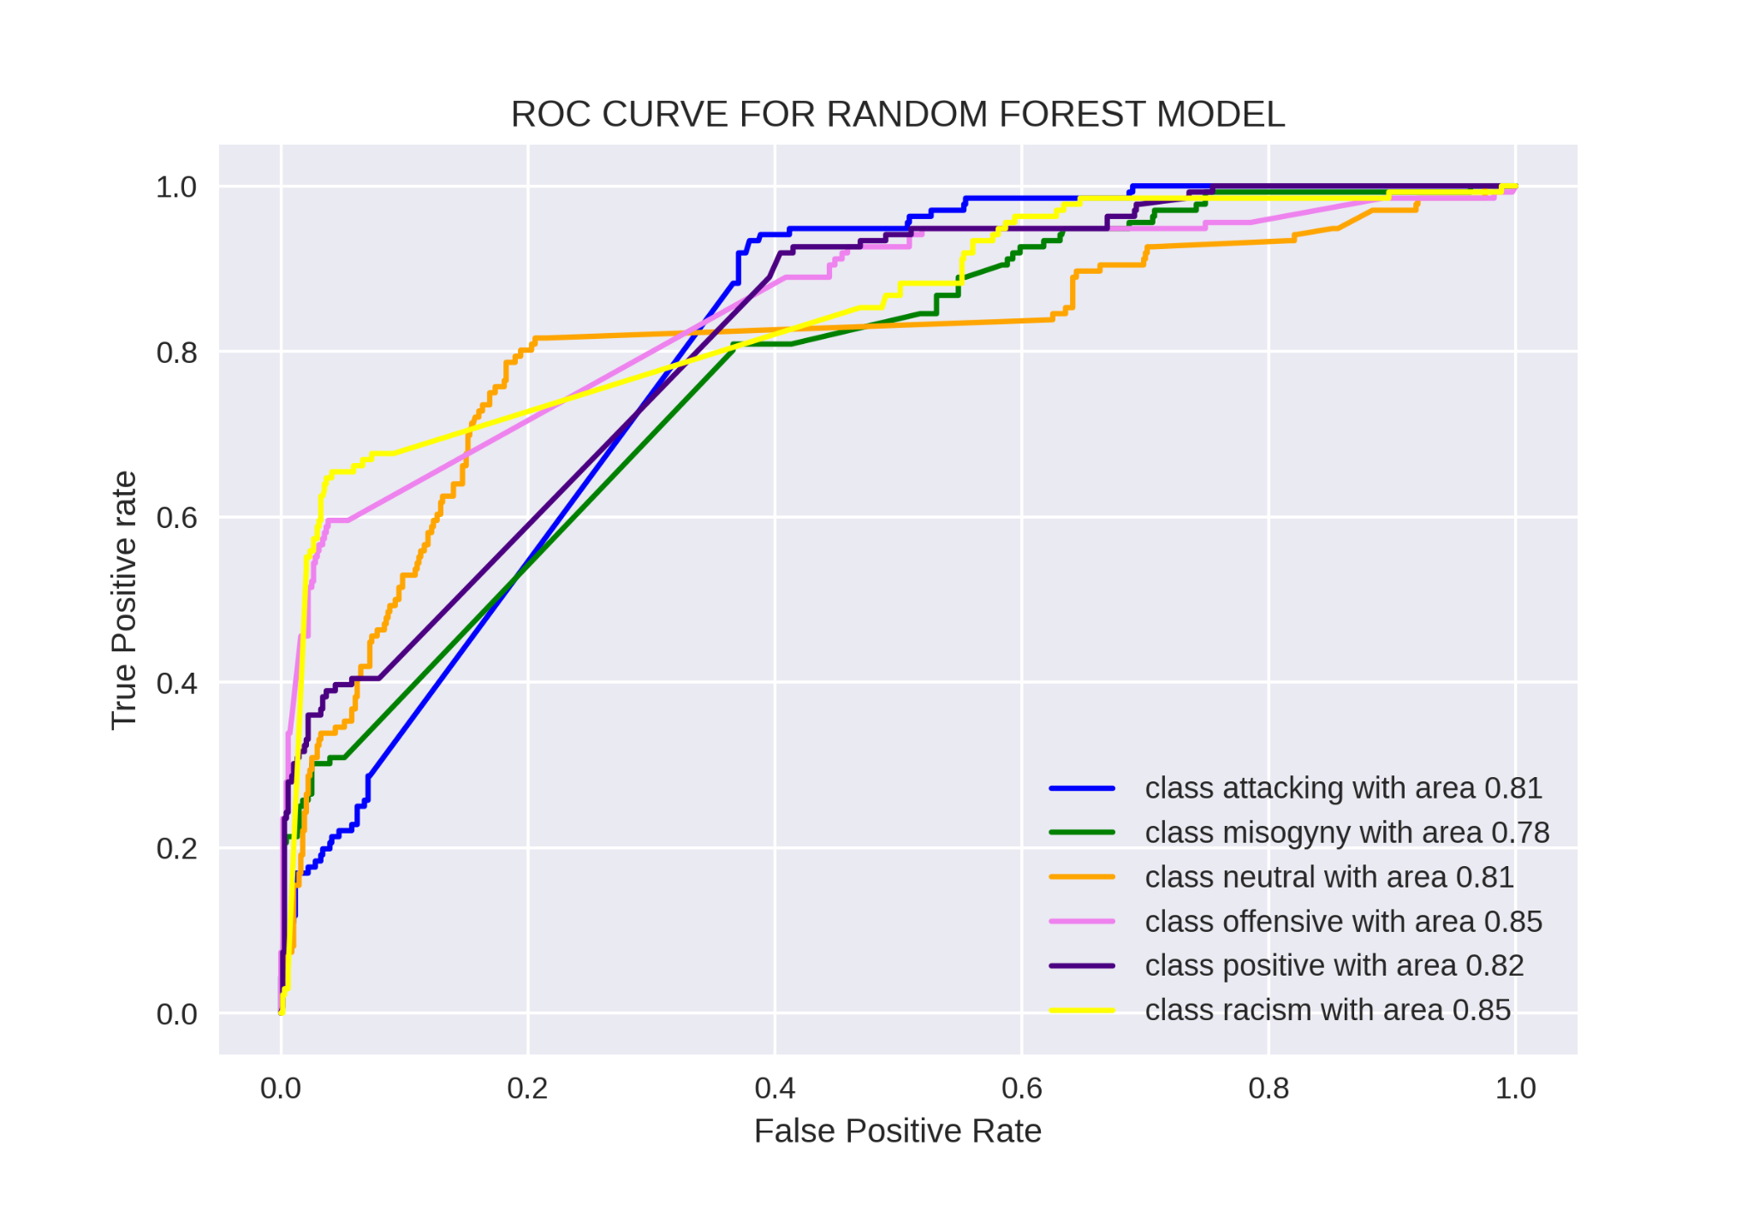
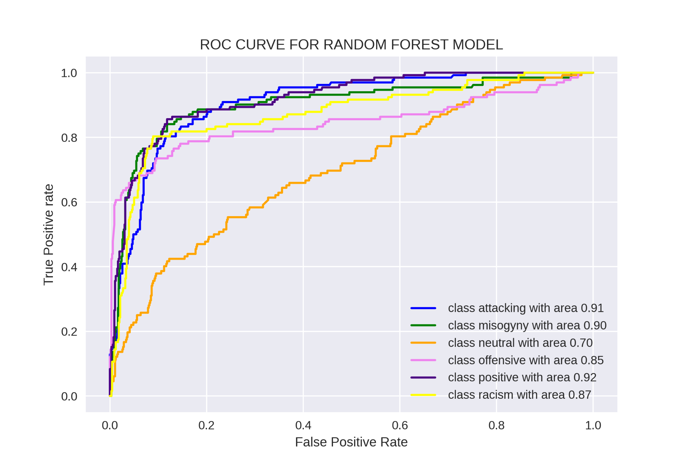
Methodology
ROC curves for RF model with BoW
ROC curves for RF model with TFIDF
26
A16 Detection and Prevention of Cyberbullying
IC4ME2 Detection and Prevention of Cyberbullying

Slide 29
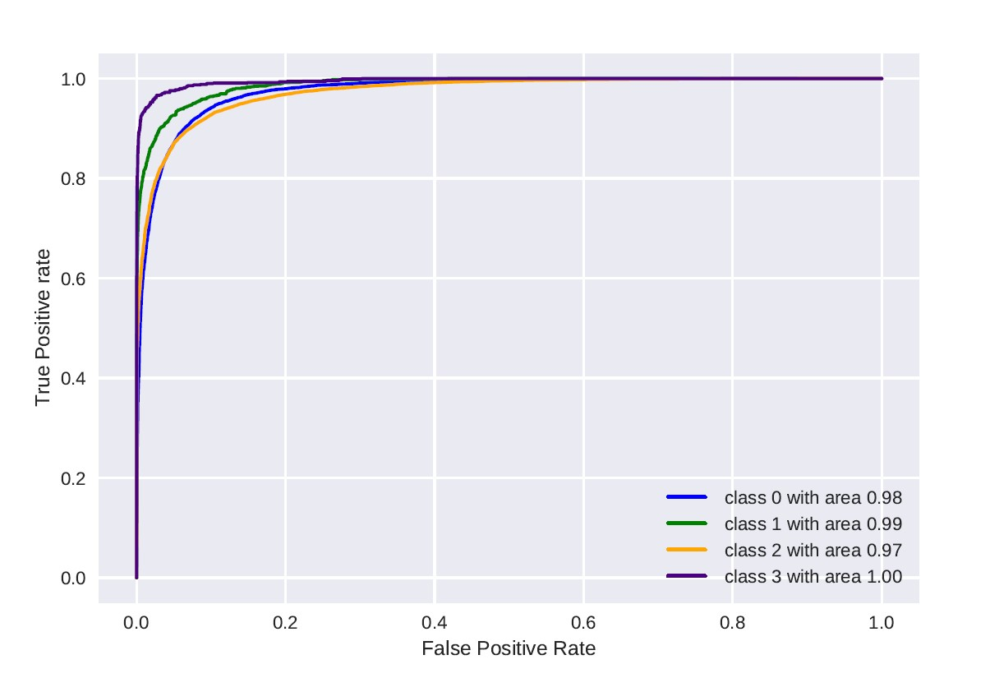
Methodology
ROC curve for model: BiLSTM with GloVe embedding
27
A16 Detection and Prevention of Cyberbullying
IC4ME2 Detection and Prevention of Cyberbullying

Slide 30
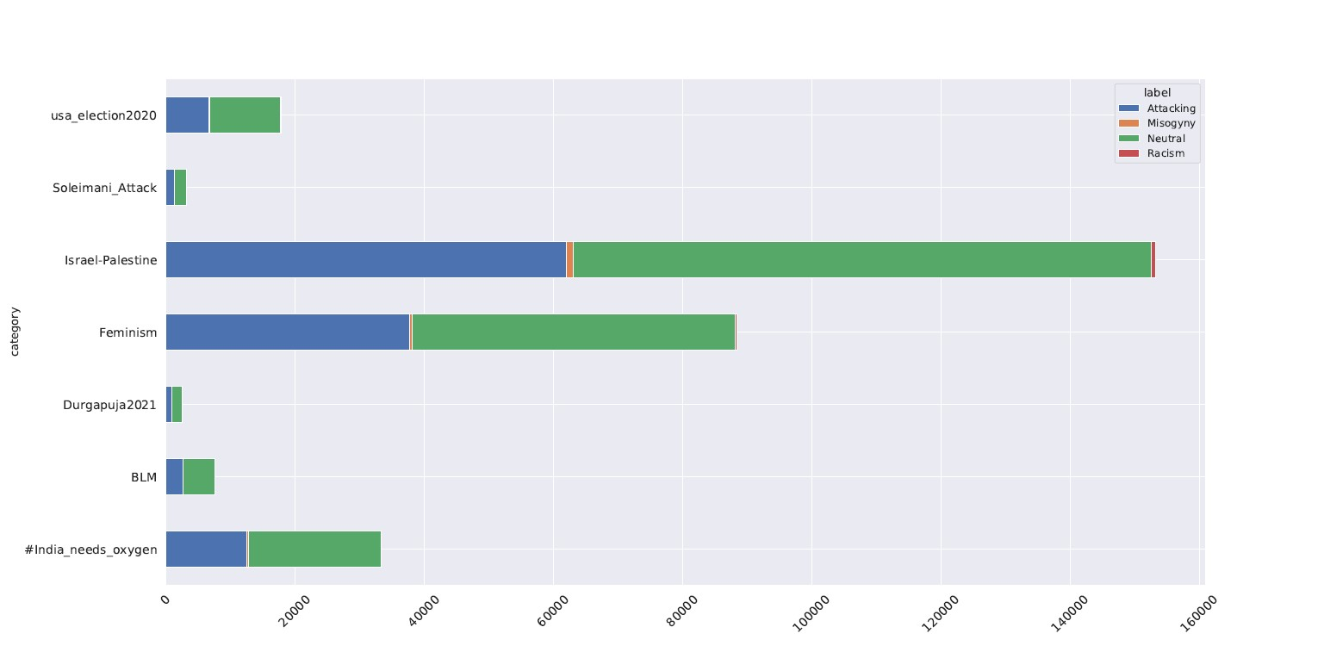
Cyberbullying Against Global Events
28
A16 Detection and Prevention of Cyberbullying
IC4ME2 Detection and Prevention of Cyberbullying

Slide 31
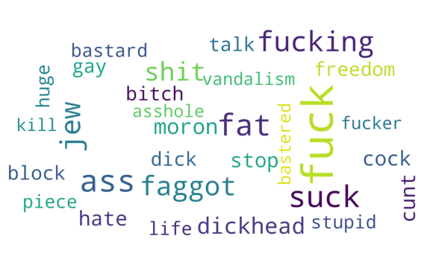
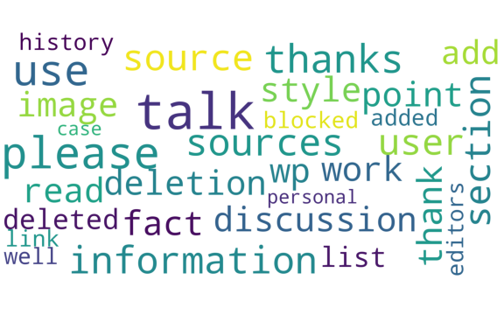
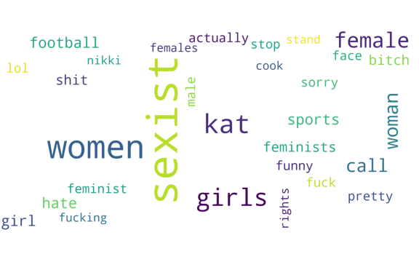
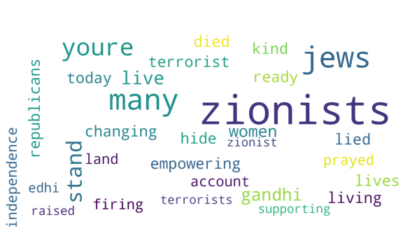
Word Clouds
Attacking
Neutral
Misogyny
Racism
29
A16 Detection and Prevention of Cyberbullying
IC4ME2 Detection and Prevention of Cyberbullying

Slide 32
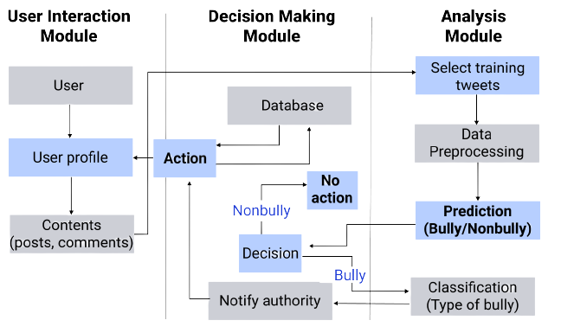
Conceptual Framework
30
A16 Detection and Prevention of Cyberbullying
IC4ME2 Detection and Prevention of Cyberbullying

Slide 33
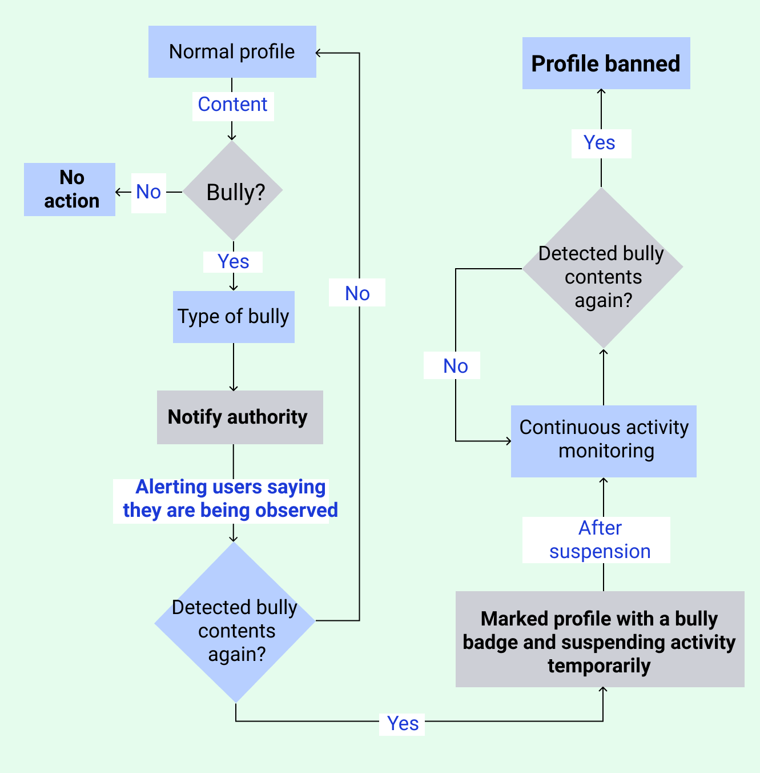
Prototype
31
A16 Detection and Prevention of Cyberbullying
IC4ME2 Detection and Prevention of Cyberbullying

Slide 34

Obtained Result
The dataset corpora extracted from Twitter are diverse in content.
The taxonomy designed for bully characteristics covers most of the areas a person is bullied for.
It is evident that the Random Forest model with TFIDF technique performs better for identification (80.8%) and BiLSTM model with GloVe embedding performs better for classification (87.7%).
The framework is targeted to contribute for social media authorities so that monitoring of bullies can be automatic and certain measures can be taken against the guilty in order to stop cyberbullying trend for good.
32
A16 Detection and Prevention of Cyberbullying
IC4ME2 Detection and Prevention of Cyberbullying

Slide 35
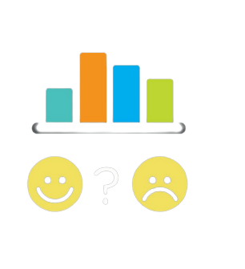
Limitation
This paper used only three NLP techniques named BoW, TFIDF, GloVe to transform text data into machine-readable vectors for feature extraction.
For both identification and classification of bullies, a limited amount of 1000 labeled tweets has been used.
Dataset corpora have been used is collected from Twitter only including the publicly available tweets as it provides a public API for data extraction.
33
A16 Detection and Prevention of Cyberbullying
IC4ME2 Detection and Prevention of Cyberbullying

Slide 36

Future Work
To contribute to cyberbully detection from trolls and memes.
To implement the proposed prevention framework as a web based solution so that we can have harmless and safer Social Media.
34
A16 Detection and Prevention of Cyberbullying
IC4ME2 Detection and Prevention of Cyberbullying

Slide 37

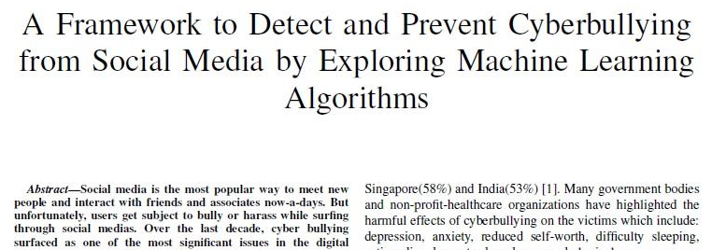
Publication
Shutonu Mitra, Tasfia Tasnim, Arr Rafi Islam, Shajahan Majib and Nafiz Imtiaz Khan. “A Framework to Detect and Prevent Cyberbullying from Social Media by Exploring Machine Learning Algorithms”, 6th International Conference on Computer, Communication, Chemical, Materials and Electronic Engineering (IC4ME2) December 26 27, 2021, Rajshahi University, Rajshahi, Bangladesh
35
A16 Detection and Prevention of Cyberbullying
IC4ME2 Detection and Prevention of Cyberbullying

Slide 38
References
[1] Van Hee, C., Jacobs, G., Emmery, C., Desmet, B., Lefever, E., Verhoeven, B., De Pauw, G., Daelemans, W. and Hoste, V., 2021. Automatic detection of cyberbullying in social media text
[2] Luceri L, Giordano S, Ferrara E. Detecting troll behavior via inverse reinforcement learning: A case study of Russian trolls in the 2016 US election. In Proceedings of the International AAAI Conference on Web and Social Media 2020 May 26 (Vol. 14, pp. 417-427)
[3] Saravanaraj, A., Sheeba, J. I., & Devaneyan, S. P. (2016). Automatic detection of cyberbullying from twitter. International Journal of Computer Science and Information Technology & Security (IJCSITS), ISSN, 2249-9555.
[4] Mihaylov T, Nakov P. Hunting for troll comments in news community forums. arXiv preprint arXiv:1911.08113. 2019 Nov 19.
[5] Weller, H. and Woo, J., 2019. Identifying Russian trolls on reddit with deep learning and bert word embeddings.
[6] LuCheng, JundongLi, Yasin.Silva, DeborahL.Hall, HuanLiu. 2019. XBully: Cyberbullying Detection within a Multi-Modal Context. In The Twelfth ACM International Conference on Web Search and Data Mining (WSDM’19), February11-15, 2019, Melbourne, VIC, Australia. ACM, New York, NY, USA, 9pages. https://doi.org/10.1145/3289600.329103
36
A16 Detection and Prevention of Cyberbullying
IC4ME2 Detection and Prevention of Cyberbullying

Slide 39
References
[7] W. D. Yu, M. Gole, N. Prabhuswamy, S. Prakash and V. G. Shankaramurthy, "An Approach to Design and Analyze the Framework for Preventing Cyberbullying," 2016 IEEE International Conference on Services Computing (SCC), 2016, pp. 864-867, doi: 10.1109/SCC.2016.125.
[8] Sugandhi R, Pande A, Agrawal A, Bhagat H. Automatic monitoring and prevention of cyberbullying. International Journal of Computer Applications. 2016; 8:17-9.
[9] S. Parime and V. Suri, "Cyberbullying detection and prevention: Data mining and psychological perspective," 2014 International Conference on Circuits, Power and Computing Technologies [ICCPCT-2014], 2014, pp. 1541-1547, doi: 10.1109/ICCPCT.2014.7054943.
[10] Yao M, Chelmis C, Zois DS. Cyberbullying ends here: Towards robust detection of cyberbullying in social media. In The World Wide Web Conference 2019 May 13 (pp. 3427-3433).
[11] Dujraskovic, Cyberbullying Statistics, Facts, and Trends (2021) with Charts. [online] Available at:https://firstsiteguide.com/cyberbullying-stats/
37
A16 Detection and Prevention of Cyberbullying
IC4ME2 Detection and Prevention of Cyberbullying

Slide 40
Thank You
Any question?
Detection and Prevention of Cyberbullying
IC4ME2 Detection and Prevention of Cyberbullying

Slide 41
Classification models:
https://colab.research.google.com/drive/16rc96sVW5yi5egObj2LDxq3uLK2BiCtj?usp=sharing
Identification models:
https://colab.research.google.com/drive/17428R3MkNLd7m3ys9afn3PseJIN2ycd7?usp=sharing
Data:
https://drive.google.com/drive/folders/1Au92HBOQSgwcQuu3I3WFGwwdwtoJF2Ge?usp=sharing
Detection and Prevention of Cyberbullying
IC4ME2 Detection and Prevention of Cyberbullying

